Slide 1
SAMRT IRRIGATION
PROJECT BATCH NO: 12
PROJECT MEMBERS
1.MEDA .SYAM KUMAR (22BQ1A0483)
2.MUNNA .SIVA TEJA (22BQ1A0490)
3.PANNURI .GANESH VARDHAN (22BQ1A0494)
4.PALLAPU .SAI MANIKANTA (22BQ1A04A7)
PROJECT GUIDE
Mrs .T.Vinnela
ASST.PROFESSOR

Slide 2
ABSTRACT
Smart irrigation technology uses weather data or soil moisture data to determine the irrigation need of the landscape. Smart irrigation technology includes: These products maximize irrigation efficiency by reducing water waste, while maintaining plant health and quality.
The logic of this system is very simple. In this system, the moisture sensor senses the moisture level of the soil and when the sensor senses a low moisture level it automatically switches the water pump with the help of a microcontroller and irrigates the plant. After supplying sufficient water, the soil gets retains the moisture hence automatically stopping the pump.The working of the soil moisture sensor is very easy to understand. It has 2 probes with exposed contacts that act like a variable resistor whose resistance varies according to the watercontent in the soil.
This resistance is inversely proportional to the soil moisture which means that higher water in the soil means better conductivity and hence a lower resistance. While the lower water in the soil means poor conductivity and will result in higher resistance. The sensor produces an analog voltage output according to the resistance.
The sensor comes with an electronic module that connects the probe to the Arduino. The module has an LM393 High Precision Comparator which converts the analog signal to a Digital Output which is fed to the microcontroller. We have covered an in-depth Arduino soil moisture Senser tutorial which covers the working of soil moisture sensor module and how to use it with the Arduino . You can check the tutorial if you want to learn more about the soil moisture sensor.

Slide 3
INTRODUCTION
Smart irrigation technology uses weather data or soil moisture data to determine the irrigation need of the landscape.
Smart irrigation systems are a new technology that uses sensors and weather data to optimize watering schedules for crops. These systems can save water and energy while also improving crop yields.
Smart irrigation systems use a variety of sensors to monitor soil moisture, weather conditions, and plant growth.
The implementation of smart irrigation systems results in a win-win situation for farmers and the environment. By optimizing water usage, farmers can significantly reduce water costs, leading to economic savings.
In the future, smart irrigation systems could be connected to other IoT devices, such as weather sensors and soil moisture sensors, to optimize water usage even further.
Irrigation helps to grow crops, maintain landscapes, and revegetate disturbed soils in dry areas and during times of below-average rainfall. In addition to these uses, irrigation is also employed to protect crops from frost, suppress weed growth in grain fields, and prevent soil consolidation.

Slide 4
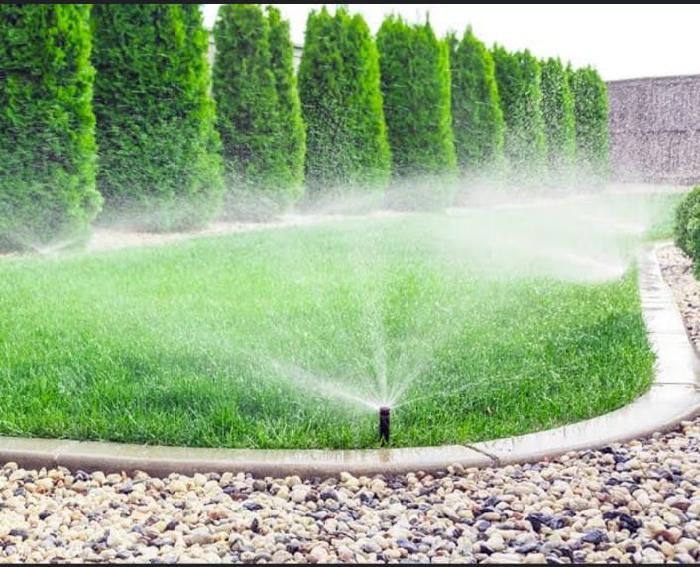
AIM
The main goal for irrigation is to provide plants with the proper amount of water at the best time. It provides the water to the soil based on the moisture content of the soil thereby reducing water wastage.

Slide 5
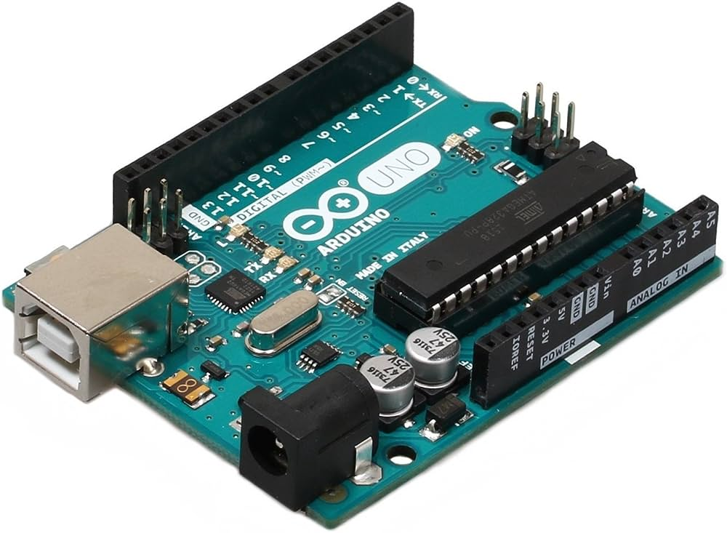
COMPONENTS USED ARDUINO UNO
The Arduino UNO is the best board to get started with electronics and coding. Arduino UNO is a microcontroller board based on the ATmega328P. It has 14 digital input/output pins (of which 6 can be used as PWM outputs), 6 analog inputs, a 16 MHz ceramic resonator, a USB connection, a power jack, an ICSP header and a reset button. It contains everything needed to support the microcontroller; simply connect it to a computer with a USB cable or power it with a AC-to-DC adapter or battery to get started.

Slide 6
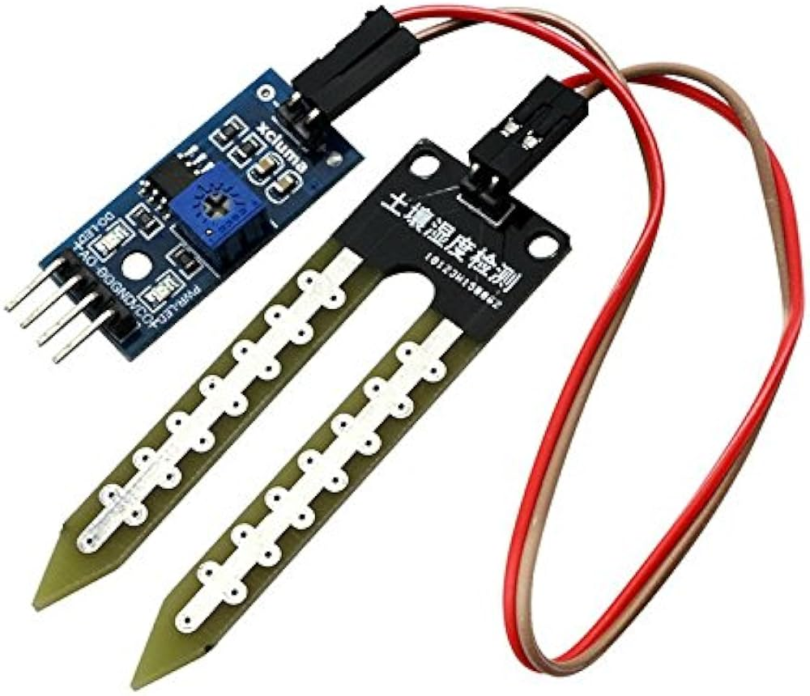
MOISTURE SENSER
Soil moisture sensors measure or estimate the amount of water in the soil. These sensors can be stationary or portables such as handheld probes. Stationary sensors are placed at the predetermined locations and depths in the field, whereas portable soil moisture probes can measure soil moisture at several locations.

Slide 7
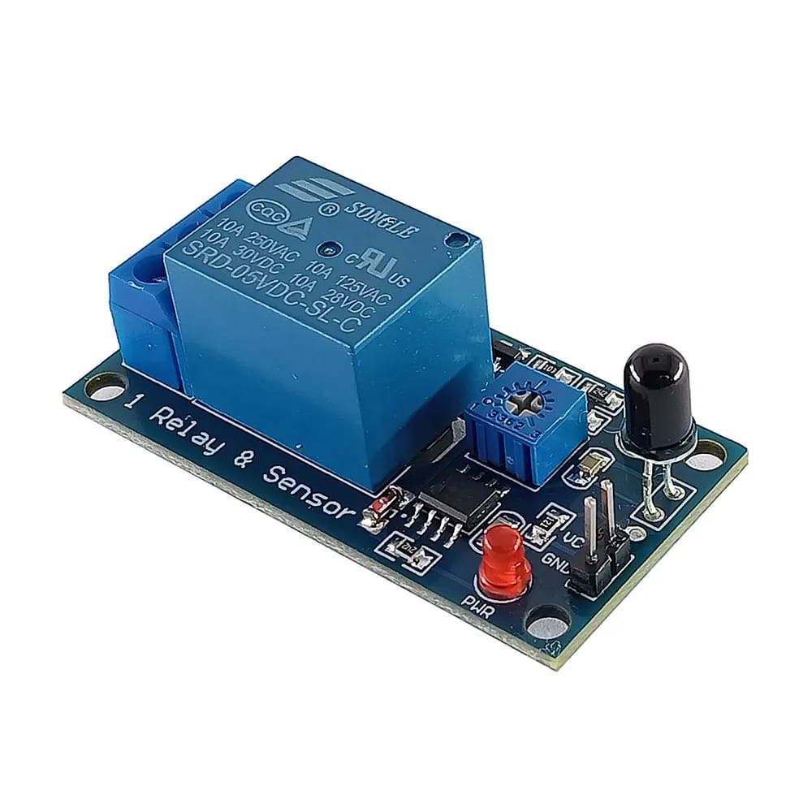
RELAY SENSOR
Relays are electrically operated switches that open and close the circuits by receiving electrical signals from outside sources.

Slide 8
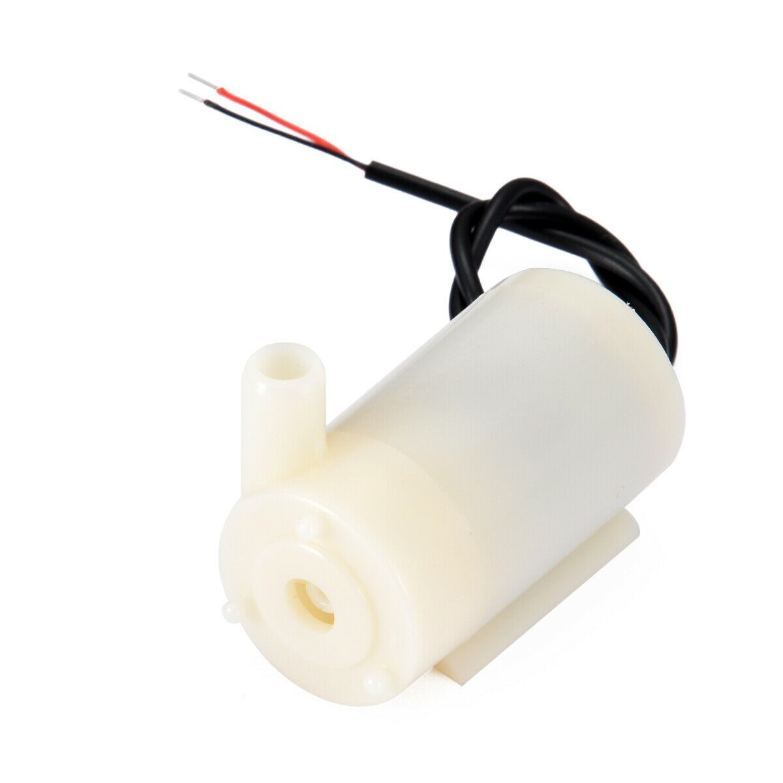
DC WATER MOTOR
DC water pumps are small pumps powered by a battery, DC power supply, or solar panel. Their primary use is to circulate,pressurize,and emulsify liquids. They are particularly useful in environments where water is in short supply.

Slide 9
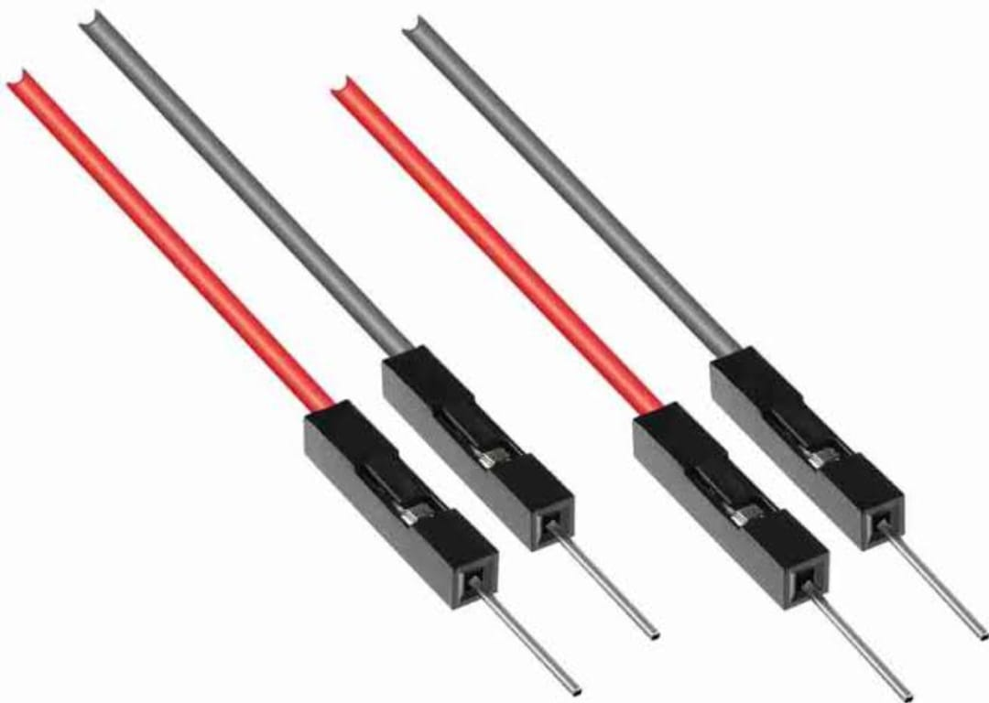
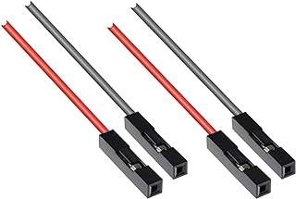
JUMPER WIRES
Jumper wires are simply wires that have connector pins at each end, allowing them to be used to connect two points to each other without soldering. Jumper wires are typically used with breadboards and other prototyping tools in order to make it easy to change a circuit as needed. Fairly simple. In fact, it doesn’t get much more basic than jumper wires. Jumper wires typically come in three versions: male-to-male, male-to-female and female-to-female

Slide 10
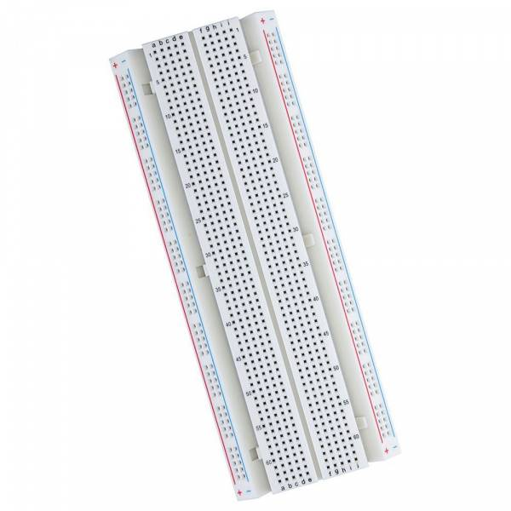
BREAD BOARD
A breadboard (sometimes called a plug block) is used for building temporary circuits. It is useful to designers because it allows components to be removed and replaced easily. It is useful to the person who wants to build a circuit to demonstrate its action, then to reuse the components in another circuit.

Slide 11
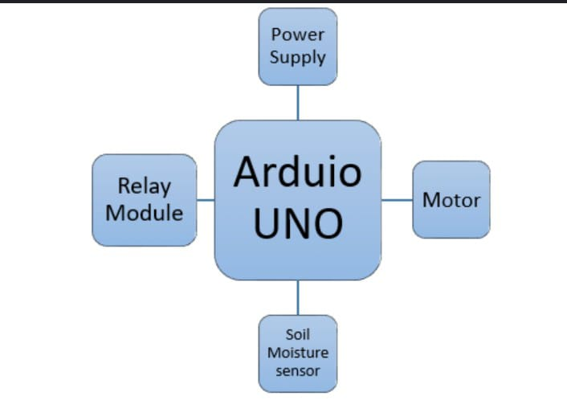
BLOCK DIAGRAMA

Slide 12
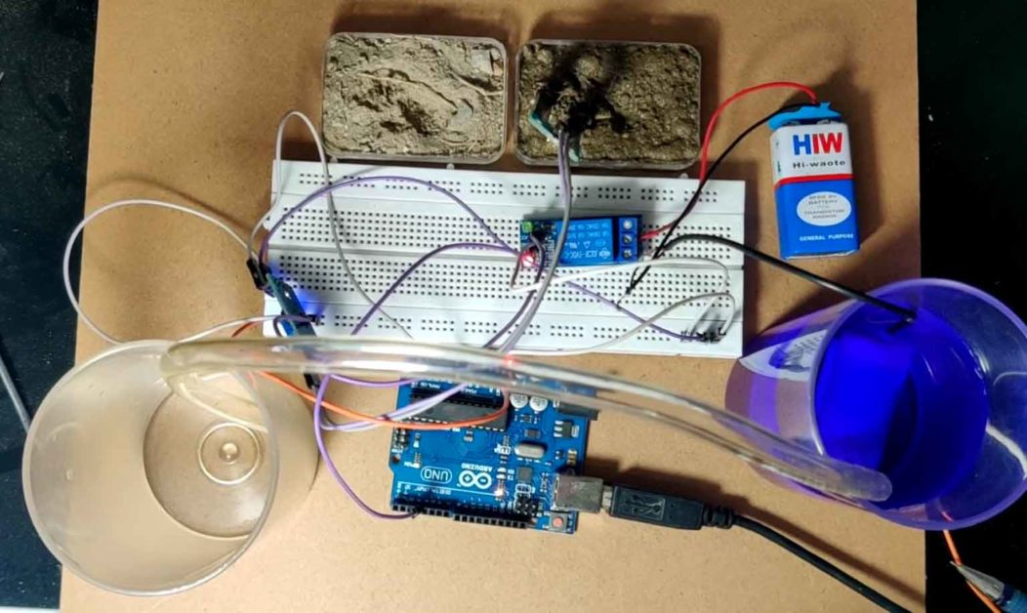
SMART IRRIGATION SYSTEM OUTPUT

Slide 13
CONCLUSION
The smart irrigation system is feasible and cost effective for optimizing water resources for agricultural production.
This irrigation system allows cultivation in places with water scarcity thereby improving sustainability.
It proves that the use of water can be diminished.
The use of solar power in this system is significantly important for organic crops

Slide 14
THANK YOU

